Slide 1

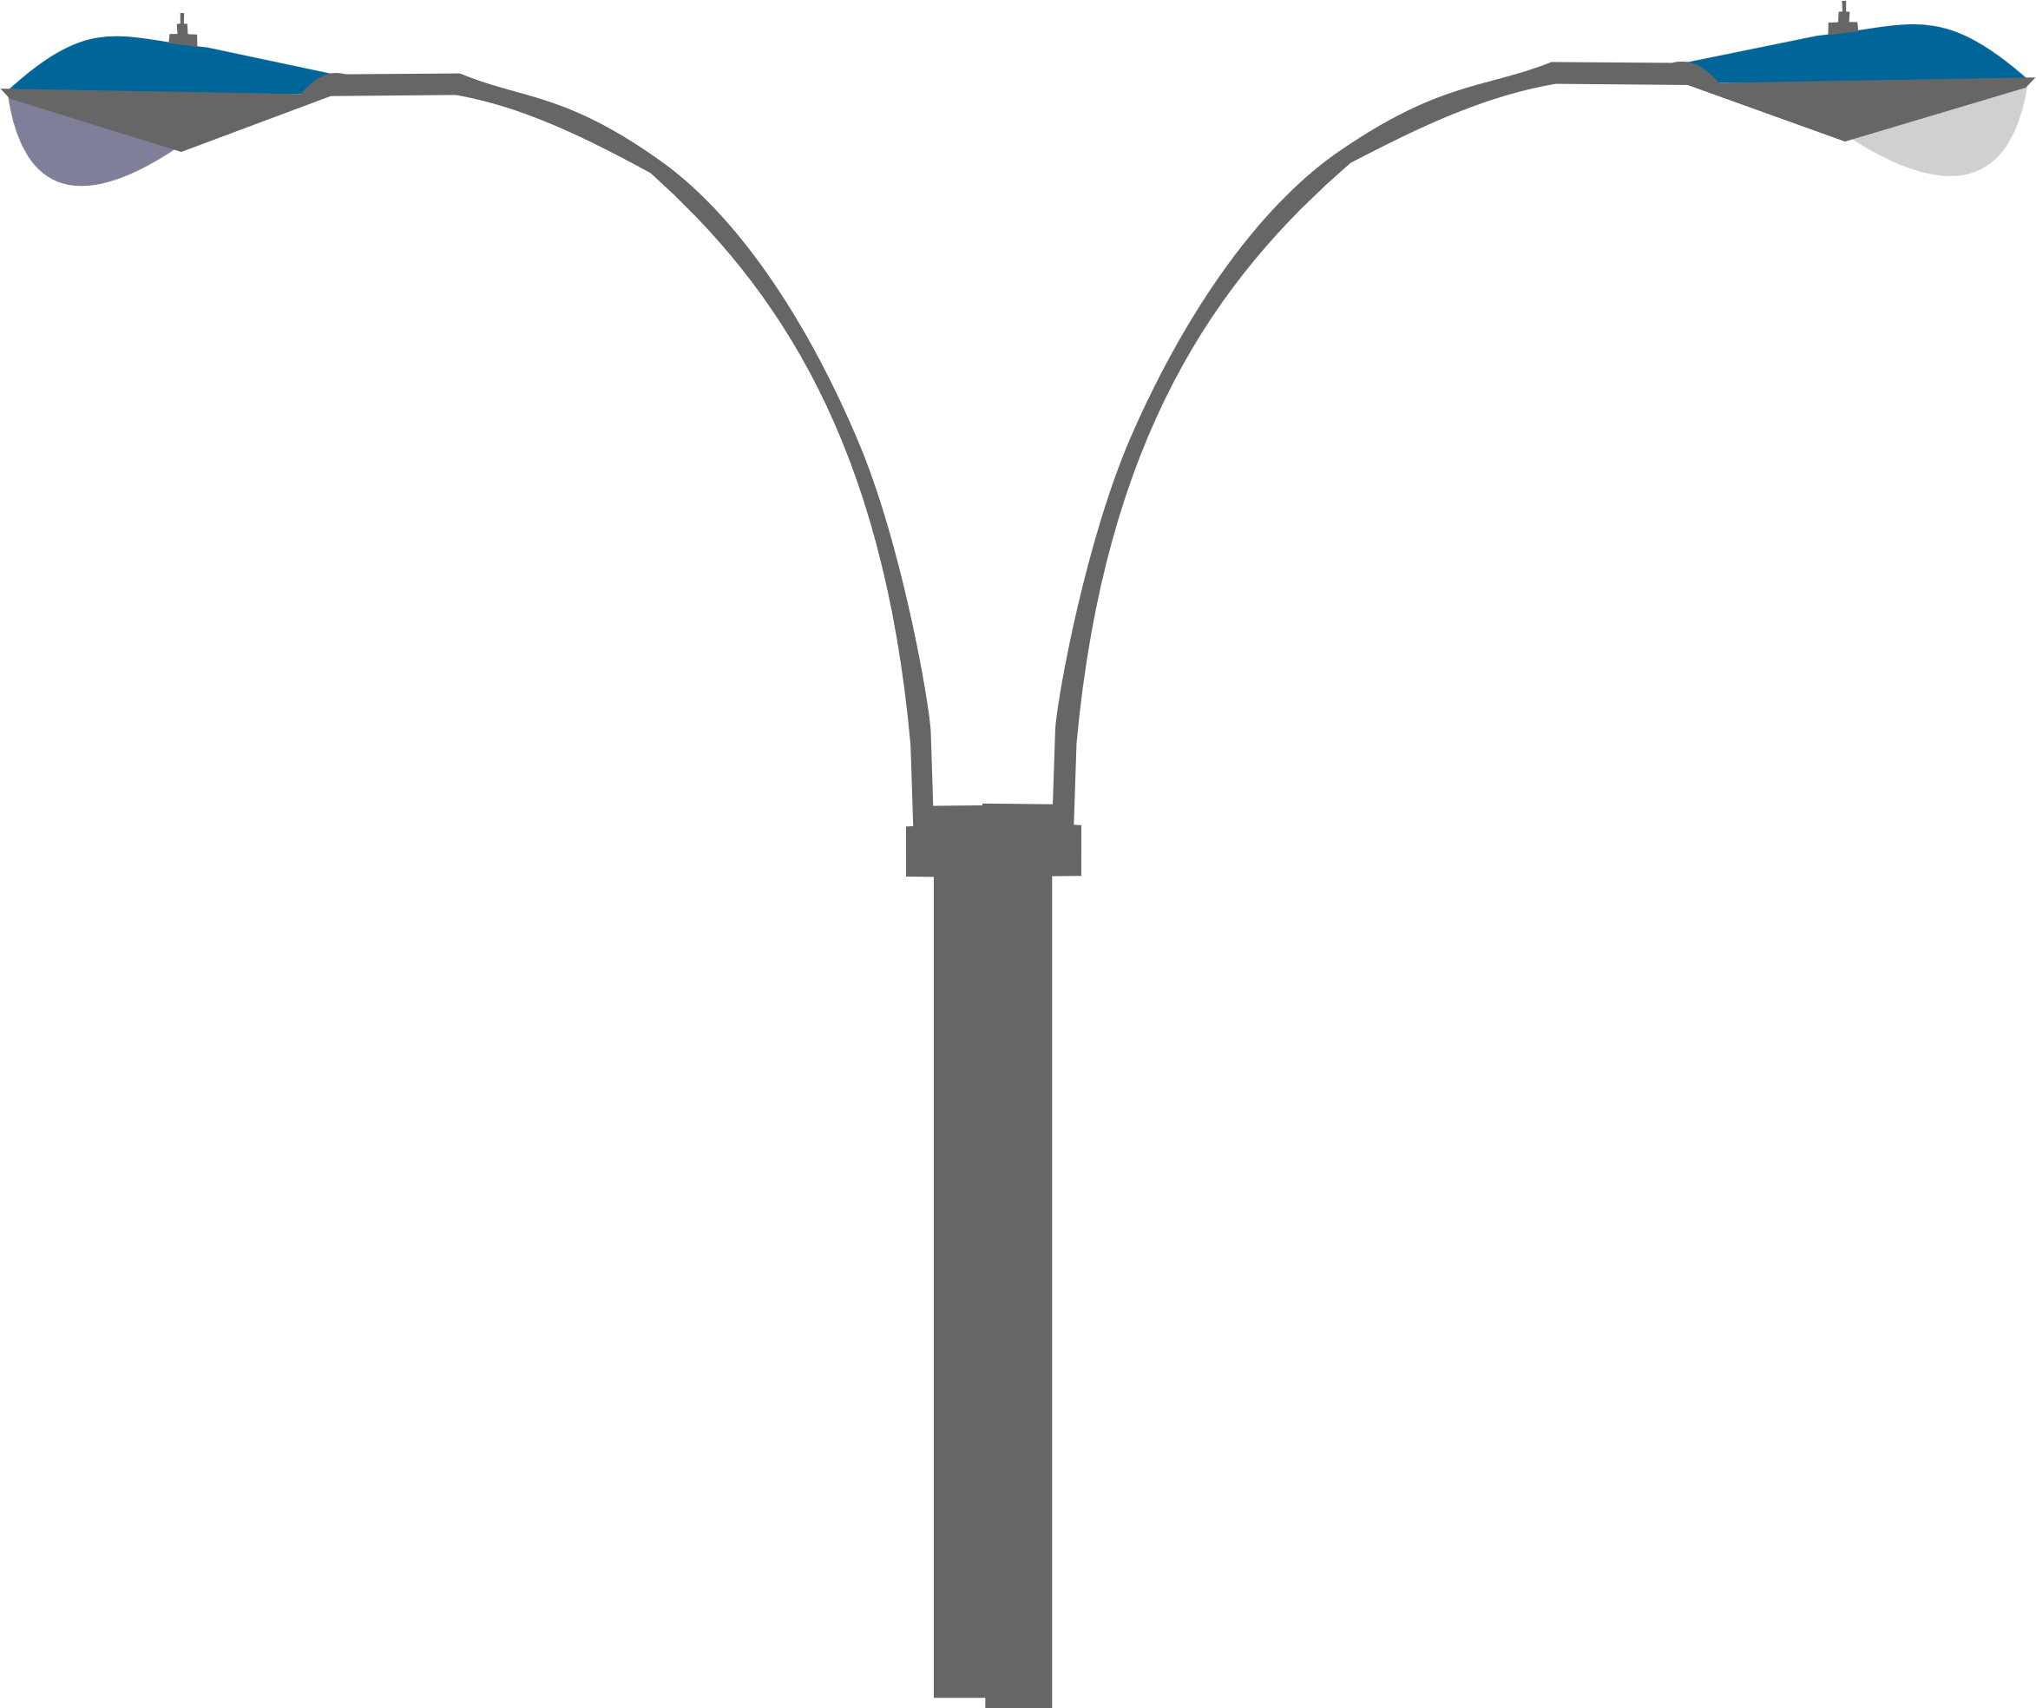

Traffic Accident Severity
Classification

Slide 2

Dataset: https://www.kaggle.com/datasets/oktayrdeki/traffic-accidents
Dataset Overview:
CSV file containing traffic accident data common fields include:
Crash date & time
Weather, lighting
roadway conditions
Driver and vehicle-related attributes
Severity level (target variable)

Slide 3


Model prediction
ML & DL Models
Dataset Preparation & Preprocessing
PROJECT Content

Slide 4




Data preparation & preprocessing
Encoding & Scaling: Applied One-Hot Encoding for categorical features and StandardScaler for numerical features
Cleaning: Removed data leakage columns (e.g., specific injury counts)
Feature Engineering: Extracted Hour, Month, and Day_of_Week from timestamps
Splitting: Used Stratified Train-Test split to maintain class ratios
Visualization 1: Analyzed correlations and environmental factors.
Visualization 2:
Class Imbalance Identified significant imbalance, with "Minor" accidents being the majority class.

Slide 5

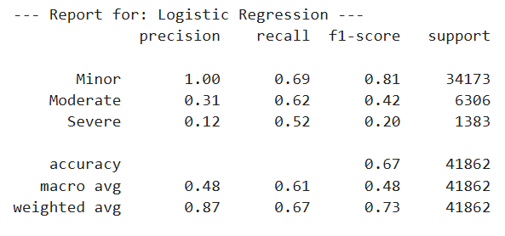
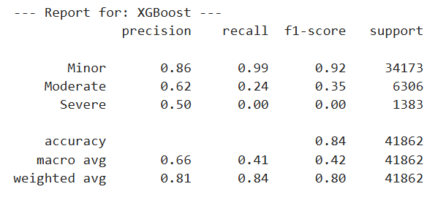
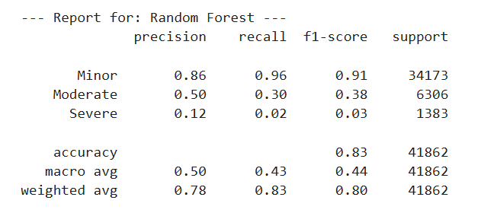
Classical ML MODELS
Model 1: Logistic Regression
Model 2: XGBoost
Model 3: Random Forest

Slide 6
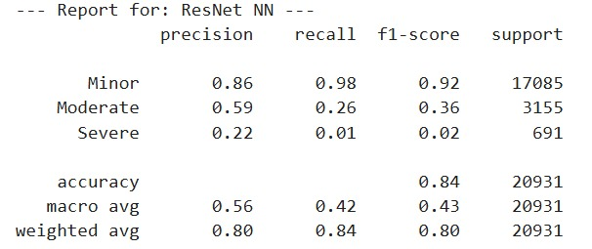
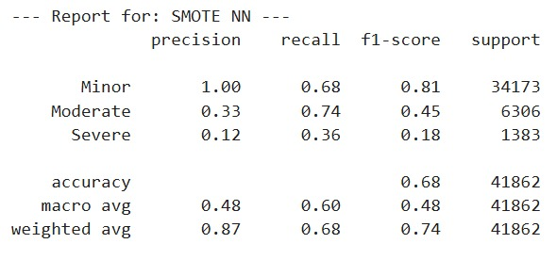

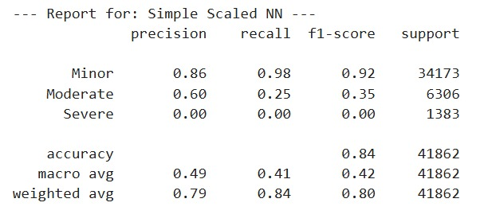
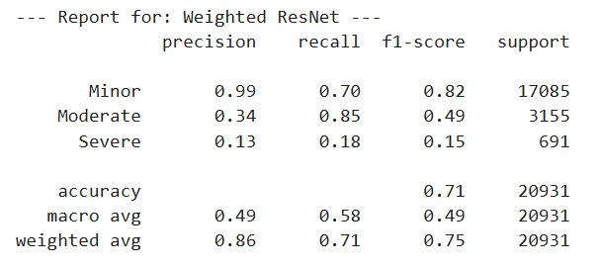
Neural Network Models
Model 1: NN-1 using ResNet architecture
Model 2: using SMOTE and Class Weights
Model 3: Using Simple Scaled NN
Model 4: NN-2 using Weighted ResNet

Slide 7

Resampling data
Handling Imbalance: Tested a resampling strategy
(Upsampling minority classes to match majority)
Result: Resampling actually
reduced accuracy to ~71%, indicating the model tried to
predict the minority classes with higher recall than ResNet
model which performed better on the major class

Slide 8
Fine tuning
1. Weight Initialization Strategy:
Applied Xavier (Glorot) Initialization to set initial random weights
to avoid vanishing or exploding gradient problems in early stagrs
2. Optimizer Comparison:
Evaluated performance across three distinct optimizers:
SGD with Momentum
RMSprop
Adam
3. Hyperparameter Tuning:
Conducted experiments to determine the optimal network structure
BS(32 vs 128),
Width (number of units per layer) to maximize accuracy without overfitting

Slide 9
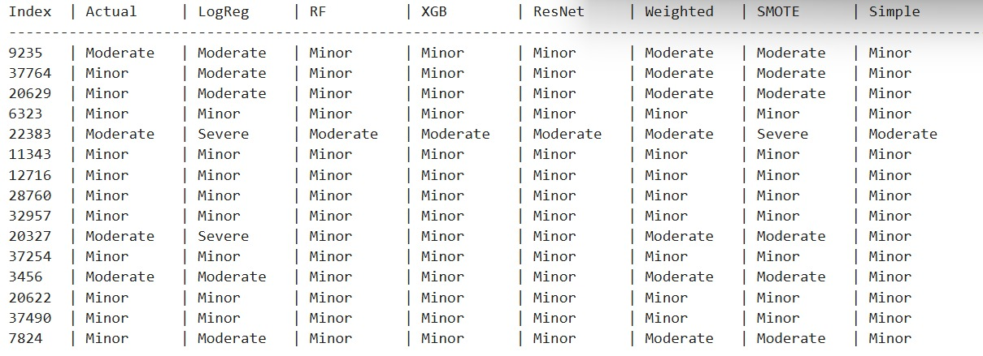
Model Prediction

Slide 10
Thank you

